Slide 1


Inspiring World's Youth with Technology
Full Stack Development Internship – Week 3
JavaScript & Interactivity

Slide 2
Internship Roadmap: Your Journey Starts Here
A quick look at what's ahead in Week 3.
01
02
About Week 2
Learning Objectives
An overview of this week's focus.
Key skills and knowledge you'll gain.
03
04
Instructions
Inspiring Quote
Key guidelines for success.
Motivation for your coding journey.
05
06
Internship Domain
Week 2 Tasks
Deep dive into Full Stack Development.
Hands-on activities and assignments.
07
08
Submission Details
Contact Us
How to submit your work.
Stay connected with us.

Slide 3

About Week 3: JavaScript & Interactivity
Week 3 introduces JavaScript, enabling interns to add logic and interactivity to webpages. Our goal is to help interns build dynamic and responsive user interfaces using JavaScript.
Goal
Focus
Help interns build dynamic and responsive user interfaces using JavaScript.
JavaScript fundamentals, event handling, and DOM manipulation techniques.

Slide 4








Learning Objectives: What You'll Master
By the end of Week 3, you will be able to understand JavaScript basics, write scripts for dynamic behavior, handle user inputs and events, and create interactive web elements.
JavaScript Basics
Logic & Control
Master variables, data types, and syntax.
Use conditions and loops effectively.
Functions & Events
DOM Manipulation
Create reusable code and handle interactions.
Dynamically modify webpage content.

Slide 5

Guidelines for a Successful Internship
To maximize your learning and ensure a rewarding experience, please adhere to these essential instructions.
Daily Discipline
Code Quality
Complete daily JavaScript tasks.
Practice coding regularly.
Test scripts in the browser.
Follow best practices.
Technical Standards
Showcase Your Work
Write clean JavaScript code.
Maintain organized file structure.
After completing Week 3 tasks, make a video of your work and post it on LinkedIn mentioning “IWY Tech” to share your progress!

Slide 6

"JavaScript brings your website to life."
Turn static pages into interactive experiences ⚡🖥️
Dynamic Content
User Interaction
Create responsive user interfaces
Handle events and user inputs
Build Interactivity
Every script adds functionality

Slide 7

Internship Domain: JavaScript & Interactivity
Week 3 focuses on adding logic and interactivity to web applications, teaching you how to create dynamic, responsive user experiences with JavaScript.
JavaScript Basics
Variables, Conditions & Loops
DOM Manipulation
Functions & Events
This structured approach ensures you grasp each concept thoroughly before moving to more complex topics.

Slide 8
Week 3 Tasks: Mastering JavaScript Fundamentals
Your journey into web styling begins with understanding the core concepts of CSS and how to apply them effectively.
Day 1: JavaScript Fundamentals
Day 2: Conditions & Loops
Learn variables, data types, operators, and basic syntax. Write simple scripts for calculations and console output.
Use if-else, switch, and loops. Create programs like number checks, counters, and simple logic-based outputs.

Slide 9
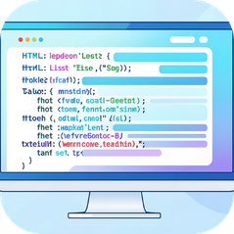
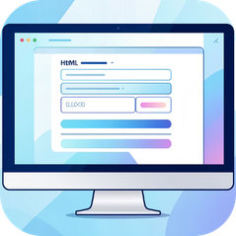
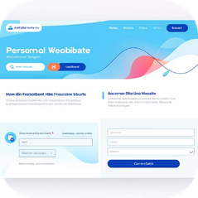
Week 3 Tasks: Functions, Events & Your First Interactive Project
Building on your HTML foundation, this week focuses on advanced CSS techniques to bring your web projects to life with sophisticated styling and layout.
Day 3: Functions & Events
Day 4: DOM Manipulation
Day 5: Mini Project
Build an interactive webpage using HTML, CSS, and JavaScript, such as: Form validation page, Interactive calculator, Dynamic content display
Create functions and trigger them using button clicks and user actions.
Access and modify HTML elements using JavaScript. Change text, styles, and content dynamically.

Slide 10

Submission & Stay Connected
Ensure your hard work is recognized by following these guidelines.
Submission Details
Contact Us
Submit via the provided Google Form.
Upload HTML, CSS, and JavaScript files in ZIP format.
Folder Name Format: YourName_Week3
Submission Deadline: 03-03-2026
LinkedIn Showcase: After completing Week 3 tasks, record a short video of your work and post it on LinkedIn mentioning “IWY Tech” to share your achievement!
We're here to support your journey. Reach out if you need help!
📧 iwytech@gmail.com
📱 +92 335 4806436

